Slide 1
Digital Filter

Slide 2
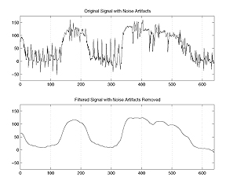
What is a Digital Filter？
In signal processing, a digital filter is a system that performs mathematical operations on a sampled, discrete-time signal to reduce or enhance certain aspects of that signal. It is a computation which takes one sequence of numbers (the input signal) and produces a new sequence of numbers (the filtered output signal).

Slide 3
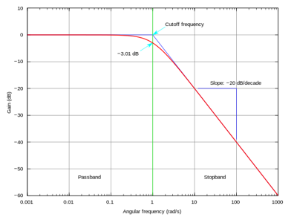
First-order Low-pass Filter
A low-pass filter is a filter that passes low-frequency signals and attenuates signals with frequencies higher than the cutoff frequency

Slide 4
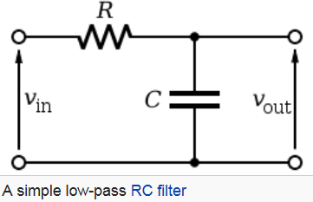
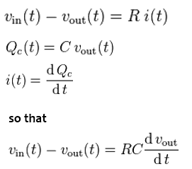
Discrete-time Realization
From the circuit diagram, according to Kirchhoff's Laws and the definition of capacitance:

Slide 5


Discrete-time Realization
The equation can be discretized. Let the samples of vin be represented by the sequence (x1,x2,…xn) , and let vout be represented by the sequence (y1,y2,…yn), which correspond to the same points in time.

Slide 6


Discrete-time Realization
That is, this discrete-time implementation of a simple RC low-pass filter is the exponentially-weighted moving average.
$$RC=\frac{1}{2πfcut }$$

Slide 7
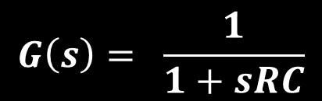

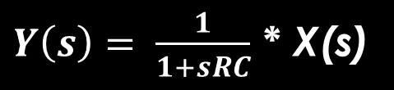
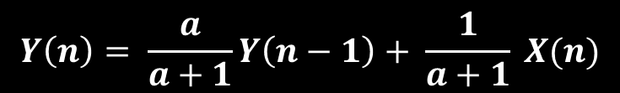

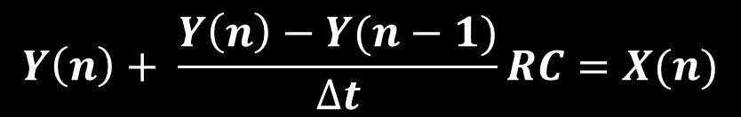
Transfer Function for LPF-1st
$$G\left(s\right)= \frac{1}{1+sRC}$$
$Y\left(s\right)= \frac{1}{1+sRC}$ * X(s)
$$Y\left(n\right)+ \frac{Y\left(n\right)−Y(n−1)}{∆t}RC=X(n)$$
$$Y\left(n\right)= \frac{a}{a+1}Y\left(n−1\right)+ \frac{1}{a+1} X(n)$$
$$a= \frac{RC}{∆t}$$
$$Y\left(n\right)=k∗Y\left(n−1\right)+\left(1−k\right)∗X(n)$$

Slide 8
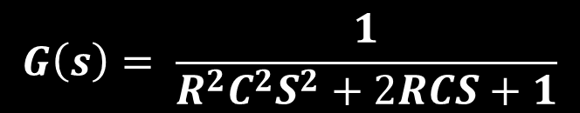
Second-Order Low-pass Filter
$$G\left(s\right)= \frac{1}{R^{2}C^{2}S^{2}+2RCS+1}$$

Slide 9
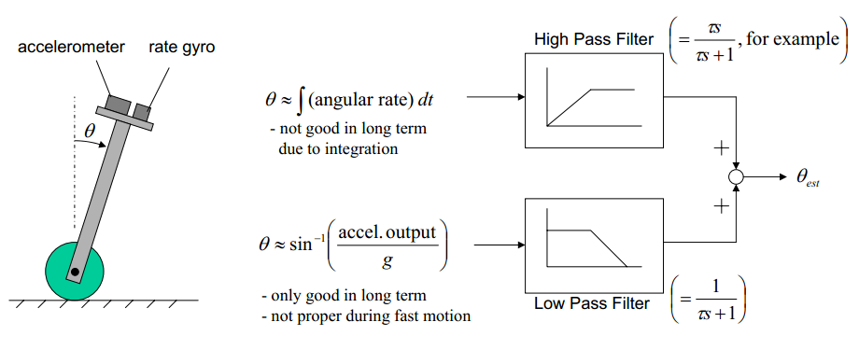
Complementary Filter
Often, there are cases where we have two different measurement sources for estimating one variable and the noise properties of the two measurements are such that one source gives good information only in low frequency region while the other is good only in high frequency region. So, we can use a complementary filter.

Slide 10
Complementary Filter
The complementary filter gives us a "best of both worlds" kind of deal. On the short term, we use the data from the gyroscope, because it is very precise and not susceptible to external forces. On the long term, we use the data from the accelerometer, as it does not drift. In it's most simple form, the filter looks as follows:
angle = (0.98)*(angle + gyro*dt) + (0.02)*(acc_angle)

Slide 11
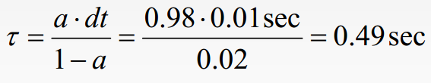
Complementary Filter
If this filter were running in a loop that executes 100 times per second, the time constant for both the low-pass and the high-pass filter would be:
For time periods shorter than half a second, the gyroscope integration takes precedence and the noisy horizontal accelerations are filtered out. For time periods longer than half a second, the accelerometer average is given more weighting than the gyroscope, which may have drifted by this point.

Slide 12
Firmware

Slide 13
Kalman Filter

